Slide 1




Assignment On Git and GitHub
Presented By : Mohd MuZakkir Saifi

Slide 2
Agenda
Git is the most Commonly used Version Control System
Introduction Of Git and GitHub
Basic Command Used In The Assignment
Creation Of Repository
Commit The File
Push and Pull Operations
Command Flow
GitHub Link
Conclusion

Slide 3
Introduction Of Git
Git is an Open Source Distributed Version Control System. Now we will try to understand this into parts.
Let me break it down and explain the working…..
Control System: This basically means that Git is a tracker. So Git can be used to store content. It is mostly
used to store code due to the other features it provides.
Version Control System: The code which is stored in Git keeps changing as more code is added. Also,
many developers can add code in parallel. So Version Control System helps in
handling this by maintaining a history of what changes have happened. Also, Git
provides features like branches and merges.
Distributed Version Control System: Git has a remote repository which is stored in a server and a local repository which is stored in the computer of each developer. This
means that the code is not just stored in a central server, but the full
copy of the code is present in all the developer’s computer. Git is a
Distributed version Control System since the code is present in every
developer’s computer.
Git Repository Structure
Working directory : This is your local directory where you make the project and make changes to it.
Staging Area : This is an area where you first need to put your project before committing.
Local Repository : This is your local repository where you commit changes to the project before pushing
them to central repository on Github.
Central Repository : This is the main project on the central server, a copy of which is with every team
member as local repository.

Slide 4
Introduction Of GitHub
GitHub is a web-based version-control and collaboration platform for software developers. Microsoft,
the biggest single contributor to GitHub, initiated an acquisition of GitHub for $7.5 billion in
June, 2018. GitHub, which is delivered through a software-as-a-service (SaaS) business model,
was started in 2008 and was founded on Git, an open source code management system
created by Linus Torvalds to make software builds faster.
GitHub is a website for developers and programmers to collaboratively work on code. The primary
benefit of GitHub is its version control system, which allows for seamless collaboration without
compromising the integrity of the original project.
Git is used to store the source code for a project and track the complete history of all changes to that code. GitHub allows developers to change, adapt and improve software from its public repositories for free, but it charges for private repositories, offering various paid plans. Each public or private repository contains all of a project's files, as well as each file's revision history.

Slide 5
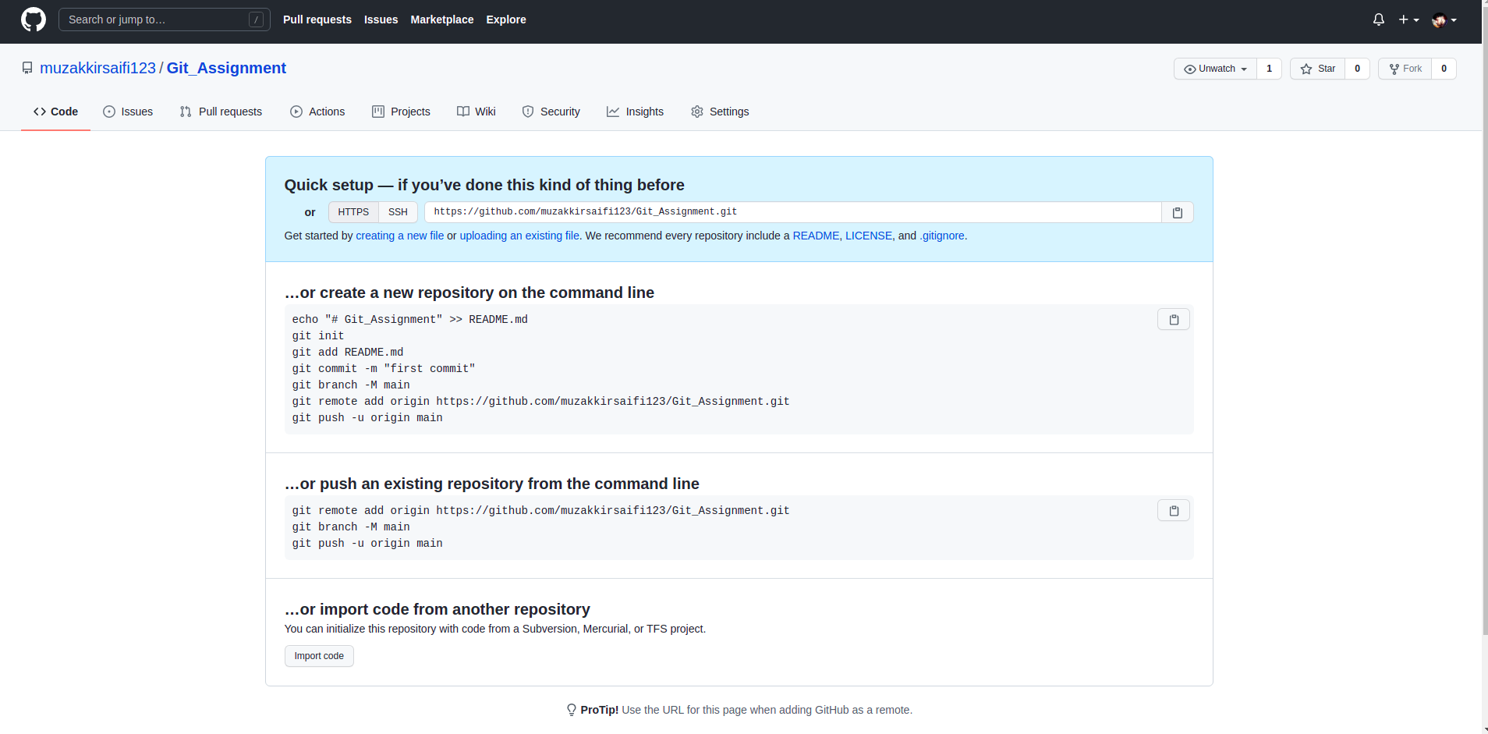

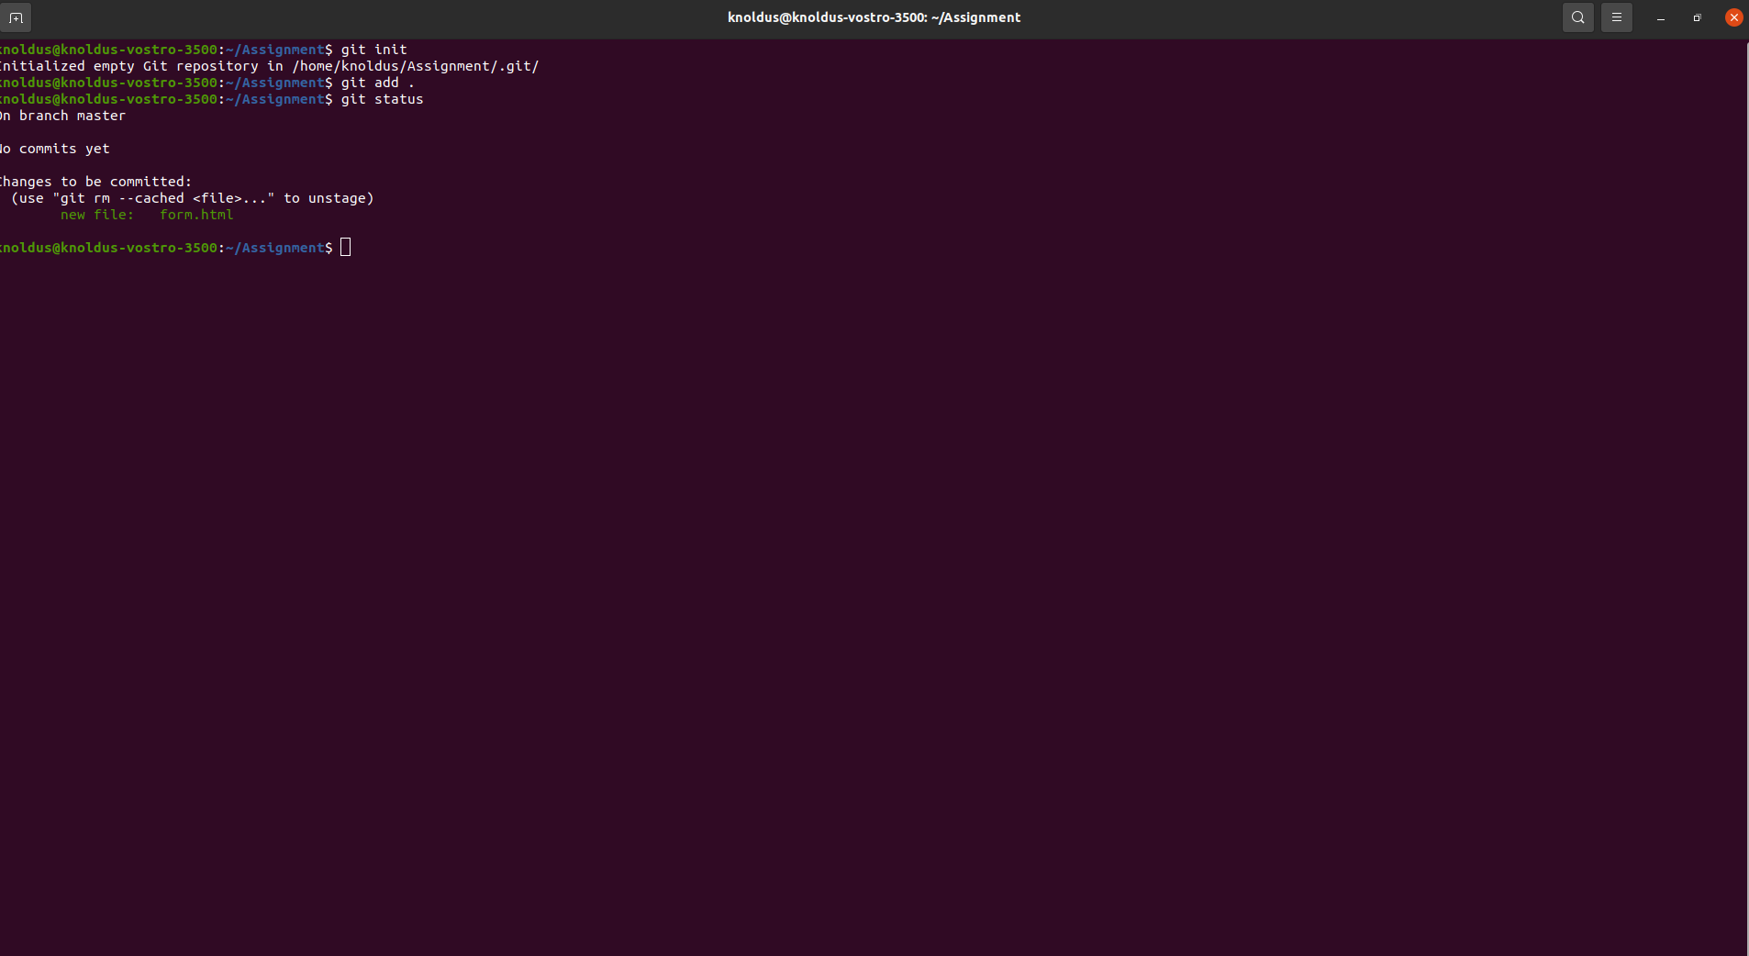
Creating An Empty Repository
Initializing the central Repository

Slide 6
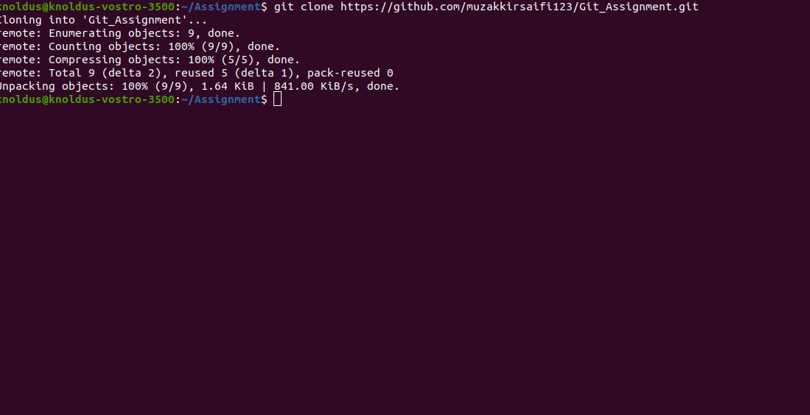
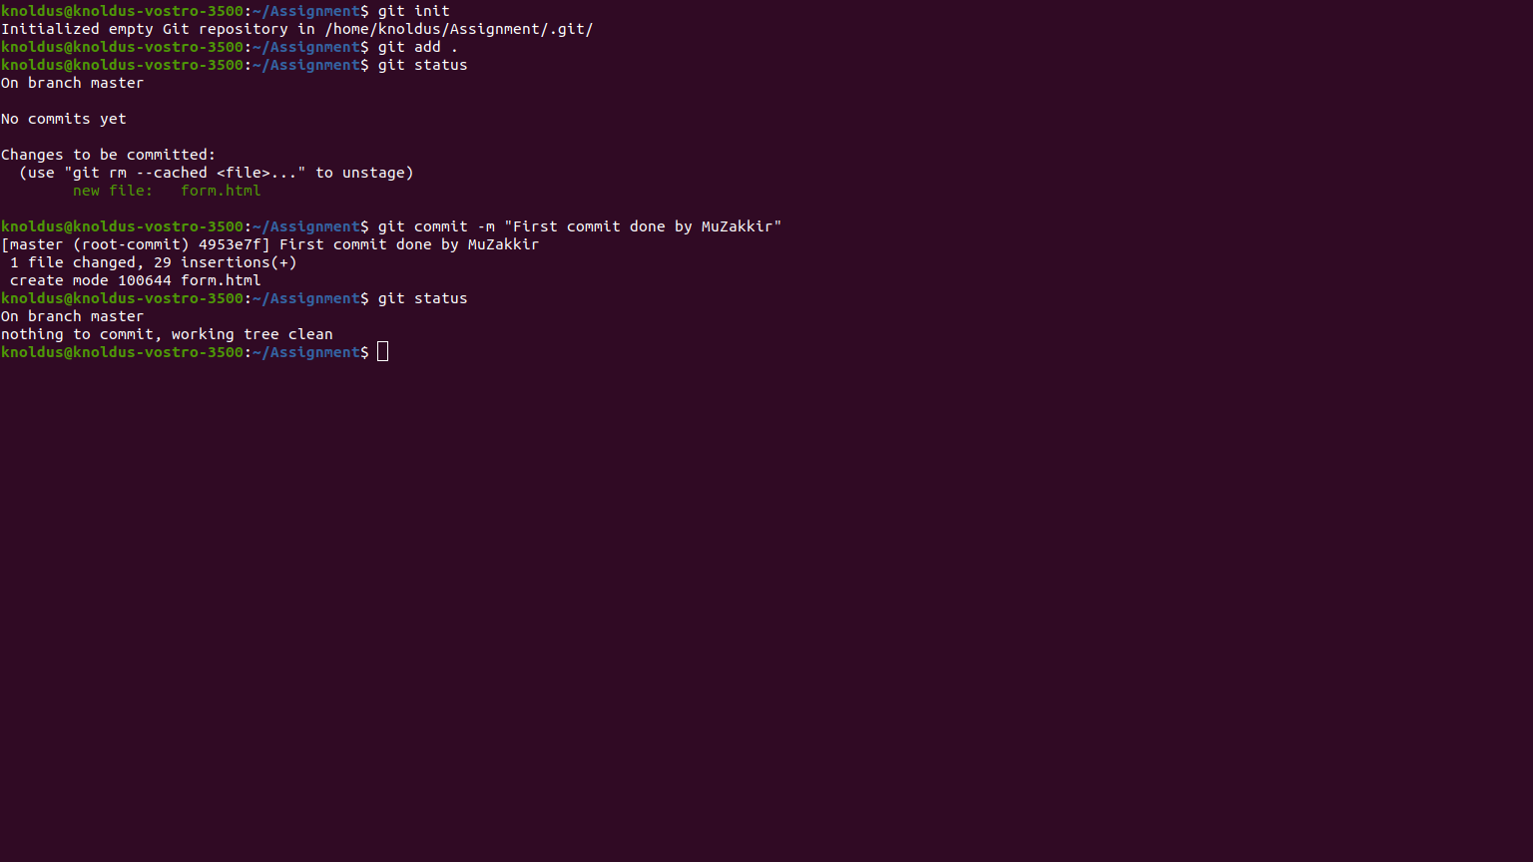
Clone the Central Repositry
Checking the status

Slide 7
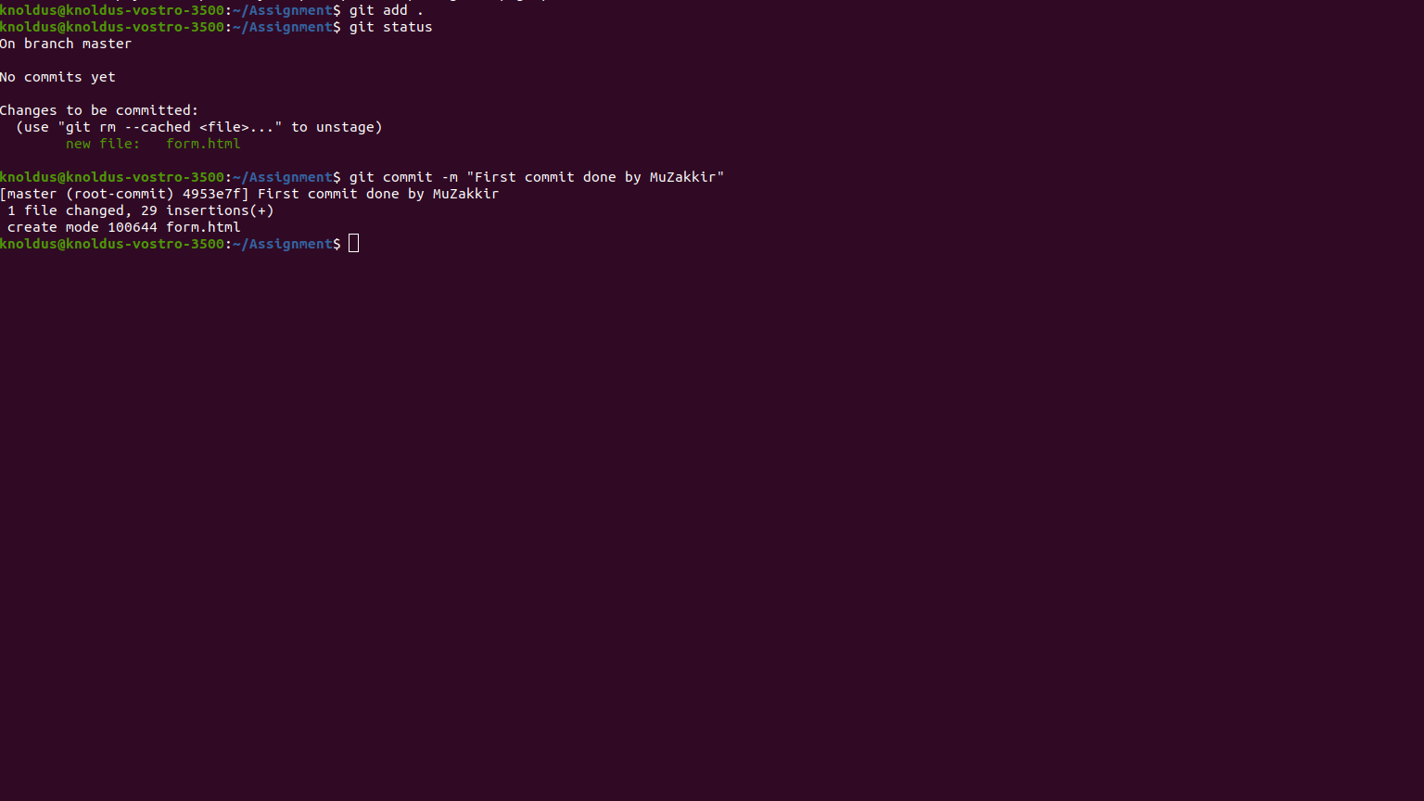
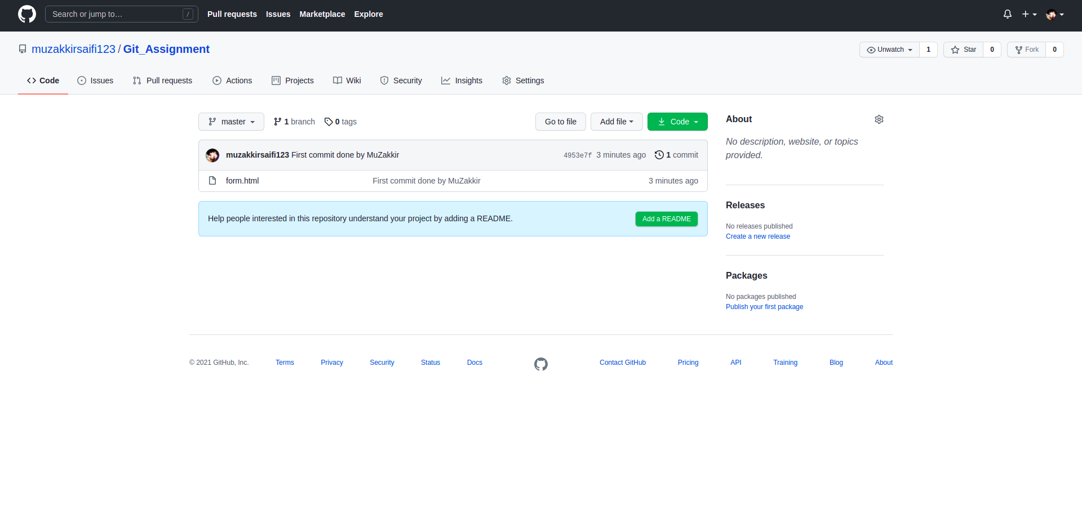
Commit The File

Slide 8
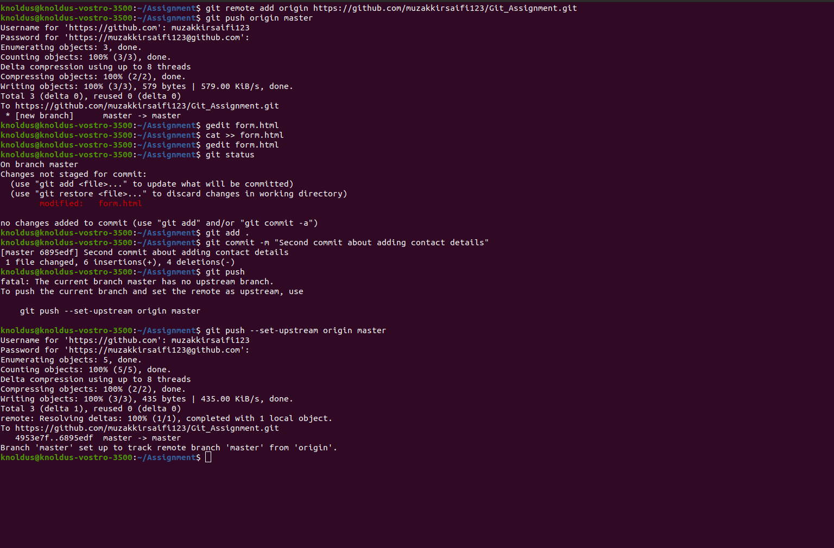
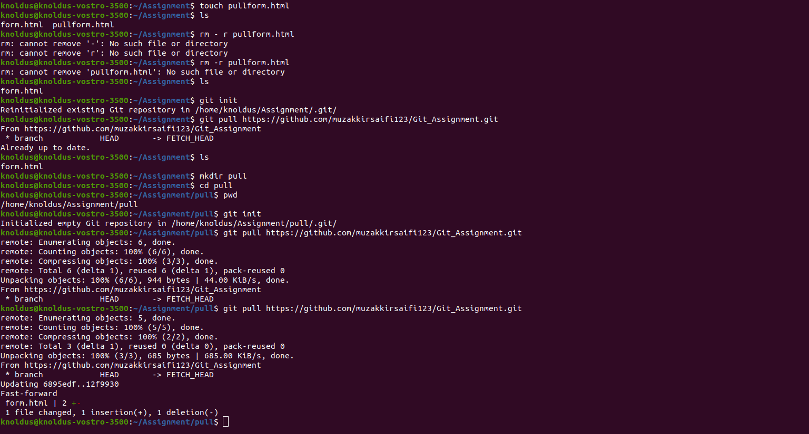
Push command
Pull Command

Slide 9
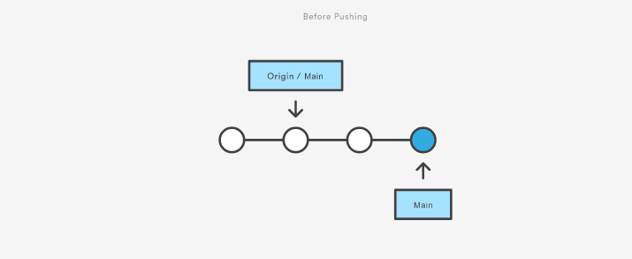

Push and Pull Operations
Git Push Operation
Git push is most commonly used to publish an upload local changes to a central repository. After a local repository has been modified a push is executed to share the modifications with remote team members.
Before Pushing
After Pushing

Slide 10

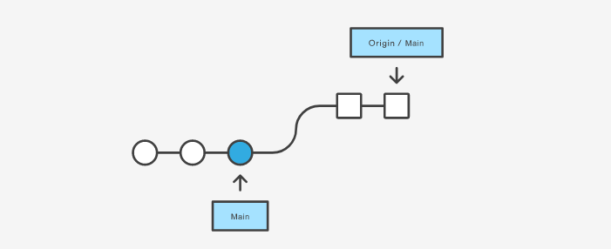
Git Pull Operation
You can think of git pull as Git's version of svn update. It’s an easy way to synchronize your local repository with upstream changes. The following diagram explains each step of the pulling process.
Current
After

Slide 11
GitHub Link
https://github.com/muzakkirsaifi123/Git_Assignment

Slide 12

Thank You!

